Slide 1
PREDICTIVE ANALYSIS ON MEDICINES & DOCTORS AVAILABILITY IN GOVERNMENT HOSPITALS
PIP2001 Capstone Project
Review-3
Batch Number:CSE-G142
Under the Supervision of,
Ms. Shweta Singh
Assistant Professor
School of Computer Science and Engineering
Presidency University
Roll Number | Student Name
20211CSE0363 | MADHU KUMAR V
20211CSE0374 | RAVI SHIVAJI MAHIPATI
20211CSE0385 | TARUN GS
Name of the Program: CSE
Name of the HoD: Dr.Asif Mohammed H.B
Name of the Program Project Coordinator: Mr. Amarnath J.L & Dr. Jayanthi. K.
Name of the School Project Coordinators: Dr. Sampath A K / Dr. Abdul Khadar A / Mr. Md Ziaur Rahman

Slide 2
Content
Introduction
Literature Review
Proposed Method
Objectives
Methodology/Modules
Software components
Timeline of Project
Expected Outcomes
Algorithm
Outputs
Conclusion
References

Slide 3
Introduction
Government hospitals in India frequently experience medicine shortages during peak disease outbreaks. This disrupts timely treatment and patient care, creating an urgent need for an efficient solution.
Our system uses analytics to predict medicine needs by evaluating historical and real-time patient data. It generates reports on required medicines and quantities, ensuring adequate stock during critical times.
Doctor availability is also a challenge, especially during peak disease periods, weekends, and holidays. The system analyses patient inflow data to predict the number of doctors required daily and ensures optimal staffing.
This program targets the Indian Government healthcare department, aiming to improve operational efficiency. By addressing medicine availability and doctor resource management, it enhances patient care during high-demand periods.

Slide 4
Literature Review
Sl.No | TITLE | AUTHOR | INFO
1 | More than Technical Perspective: Analysing the possibilities of Unstructured data in Healthcare industry. | Yi Chuan Wang, LeeAnn Kung, Chaochi Ting | The research highlights the underutilization of big data technology in healthcare and aims to improve strategies by exploring its architecture, features, and potential to enhance patient care and medicine availability.
2 | Learning, schooling, and data analytics | Baker, R. S. J. D | Educational Data Mining (EDM) and Learning Analytics (LA) are new approaches that use big data to improve learning. EDM focuses on studying and validating learning models, while LA aims to help teachers improve their methods using research insights.
3 | Big data analytics in healthcare: promises and possibilities. | Raghupathi. W | This paper discusses the benefits of using big data technologies in healthcare, focusing on frameworks and methodologies to improve efficiency, reduce costs, and advance the system with modern technologies like AI and machine learning.

Slide 5
Existing method Drawback
Mistakes: Manual tracking can lead to counting errors in medicine and doctor availability.
Takes Too Long: Traditional methods are slow and can be inefficient, especially when demand is high.
Slow Decisions: Delayed information makes it hard for hospitals to respond quickly to shortages.
Fixed Schedules: Doctors often have set schedules that don’t change based on patient needs, causing shortages or excess staff.
Simple Predictions: Basic forecasting methods overlook important factors, leading to inaccurate demand predictions.
Old Information: Reports can be outdated, which means decisions may not be based on the most current data.

Slide 6
Proposed Method
Data Collection: Gather past and current patient information in one place.
Predictive Analytics: Use data models to predict future medicine needs.
Medicine Reports: Create reports showing which medicines are needed and how much.
Real-Time Tracking: Monitor medicine stock and get alerts when supplies are low.
Doctor Demand Forecasting: Predict how many doctors are needed based on patient numbers.
Better Doctor Scheduling: Suggest doctor shifts that match busy times.
Resource Planning: Give advice on how to best use doctors and medicines.
Improving Models: Update prediction models with new information for better accuracy.
Government Connection: Help hospitals and the government work together smoothly.

Slide 7
Objectives
The primary objective is to ensure the availability of essential medicines in government hospitals during peak disease times. By leveraging analytics, the system predicts medicine requirements based on patient data.
Another objective is to optimize doctor availability by analyzing patient inflows and historical trends. This ensures that hospitals have adequate staffing, particularly during weekends, holidays, and disease outbreaks.
The system aims to enhance operational efficiency in hospitals by providing timely and data-driven reports. These reports help hospitals manage both medicine and doctor resources effectively.
Overall, the program targets the Indian Government healthcare sector, focusing on improving resource management. It strives to ensure that hospitals are better equipped to handle surges in patient demand, improving patient care outcomes.

Slide 8
Methodology/Modules
Step 1: Data Collection and Integration Collect data on patients, medicines, and doctor availability from hospitals to understand resource needs.
Step 2: Data Cleaning and Pre-processing Clean and standardize the data to ensure accuracy and consistency for analysis.
Step 3: Demand Forecasting for Medicines Use analytics to predict which medicines will be needed based on patient inflow and disease trends.
Step 4: Doctor Availability Forecasting Analyse patient inflow to estimate how many doctors and specialists are required daily or during peak times.
Step 5: Real-Time Monitoring and Alerts Implement alert systems to track low medicine stock levels and doctor shortages in real-time.
Step 6: Reporting and Dashboard Create reports and dashboards that show medicine availability and doctor resource requirements.
Step 7: Continuous Feedback Loop Continuously refine the system using new data and feedback from hospital staff for improved performance.
Step 8: Implementation and Scalability Pilot the system in select hospitals, improve based on results, and then scale it to more hospitals.

Slide 9
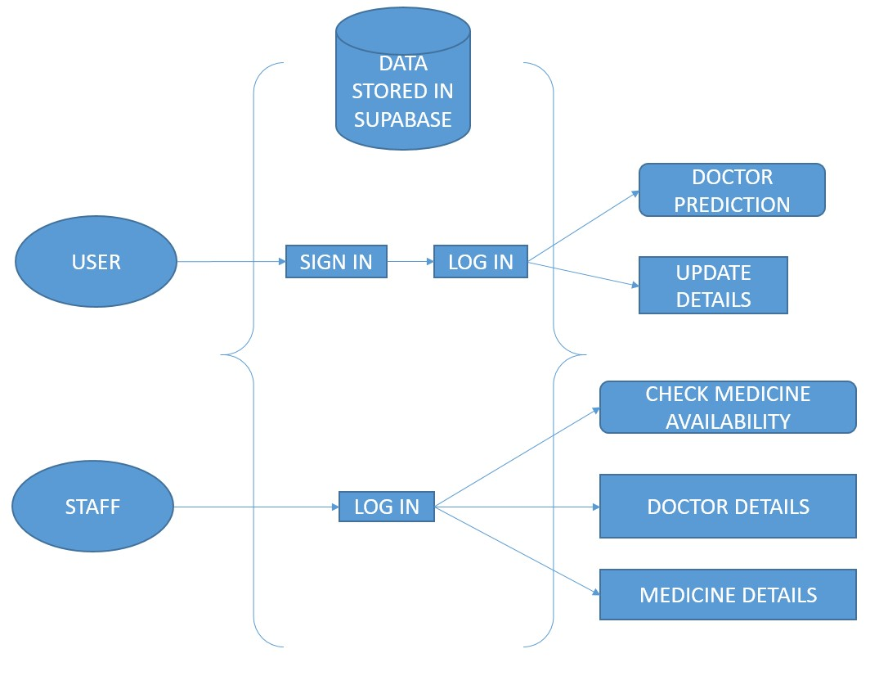
Architecture

Slide 10
Software components
a) FRONT-END PART: • CSS(Cascading Style Sheets)
• JSX(JavaScript XML)
b) BACK-END PART: • JAVA SCRIPT
• PYTHON
• PKL
c) DATABASE: • Supabase

Slide 11
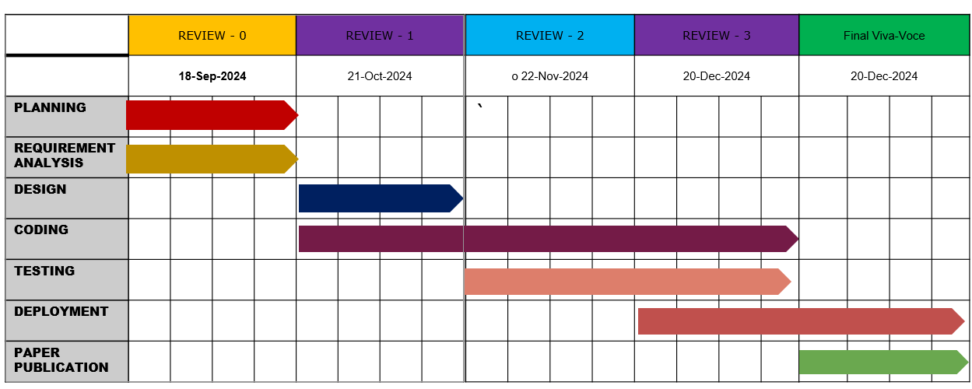
Timeline of Project

Slide 12
Expected Outcomes
Improved Medicine Availability: Accurate forecasts ensure timely stock of essential medicines during peak periods.
Optimized Doctor Allocation: Dynamic scheduling meets patient needs during high-demand times like weekends and holidays.
Enhanced Operational Efficiency: Real-time data and reports streamline hospital resource management and decision-making.
Reduced Patient Wait Times: Better doctor availability minimizes delays in treatment during disease outbreaks.
Informed Government Planning: Predictive insights support government healthcare policies and planning.

Slide 13
Algorithm
Algorithm for Authentication and Security
1. User Authentication
Signup
a. User submits form with name, email, and password.
b. Validate inputs (e.g., password strength, email format).
c. Encrypt the password.
d. Store the details in the users table.
e. Return a success message on successful signup.
Login
a. User submits email and password.
b. Retrieve and validate credentials from the users table.
c. If valid, grant access; else, display an error message.
2. Staff Authentication
Login
a. Staff submits email and password.
b. Retrieve and validate credentials from the staffs table.

Slide 14
c. Use role-based access control to determine access privileges.
3. Data Security
Encrypt all sensitive data before storage (e.g., passwords using hashing).
Use HTTPS for secure data transmission.
Implement role-based access to ensure data isolation.
_______________________________________
Algorithm for Doctor Availability Predictor
1. Input Selection
User selects specialization, enters patient load, and selects location.
2. Prediction Process
a. Use the inputs to query historical data (stored in a CSV or database).
b. Apply a machine learning model (e.g., Logistic Regression or Decision Tree):
Features: specialization, patient load, location.
Output: probability of availability.
c. Generate a message based on the probability:
Doctor Not Available if probability < 0.4.
Doctor Available if probability >= 0.4.
________________________________________
Algorithm for User Interface to Update Details
1. Update Form Display
a. User clicks "Update Details".

Slide 15
b. Fetch current details from the users table and populate form fields.
2. Form Submission
a. Validate input fields.
b. Update user details in the database.
c. Refresh user profile and display a success message.
_______________________________________
Algorithm for Staff Dashboard
1. Medicine Availability Prediction
Staff selects medicine, dosage, and location.
Use the ML model to predict availability:
Medicine Not Available if probability < 0.4.
Medicine Available if probability >= 0.4.
2. Doctor and Medicine Details Management
a. Search: Use the key-value pairs to filter the respective CSV or database.
b. Add Row: Append the new entry to the CSV or database.
c. Delete Row: Identify and remove the entry matching the key-value pair.
________________________________________
Algorithm for Data Fetching
1. Doctor Details
Load data from Doctor Dataset CSV into the system.
Display or edit using the Doctor CSV Editor.

Slide 16
2. Medicine Details
Load data from Medicine Availability CSV.
Display or manage using the Medicine CSV Editor.
________________________________________
Algorithm for Suparbase Database Structure
1. User Authentication
Query the users table for user credentials.
2. Staff Authentication
Query the staffs table for staff credentials.
3. Unified Authentication
Use auth.users for authentication of both users and staff.
Identify the user role (e.g., regular user or staff) post- authentication.

Slide 17
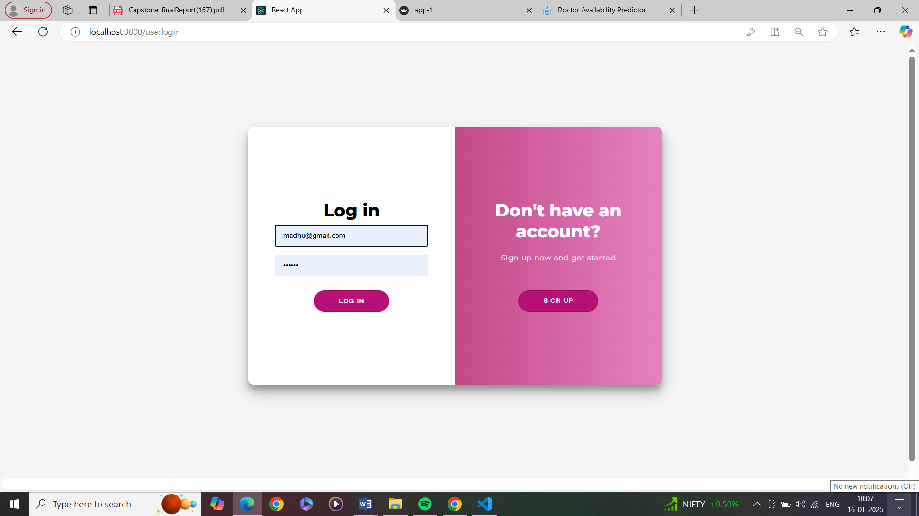
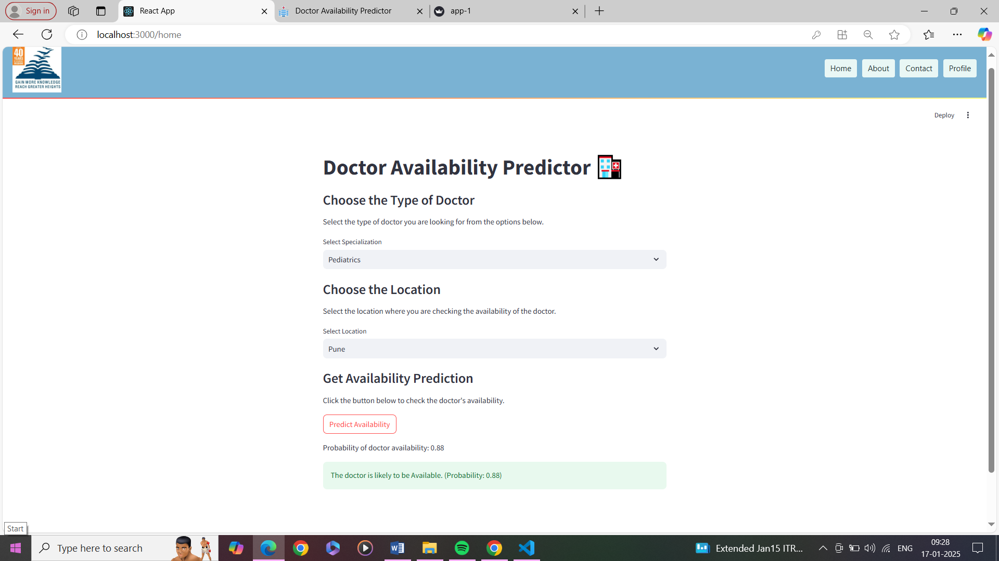
SCREENSHOTS
Fig 1.5 user side doctor availability predictor
Fig 1.3 user signup and login page

Slide 18
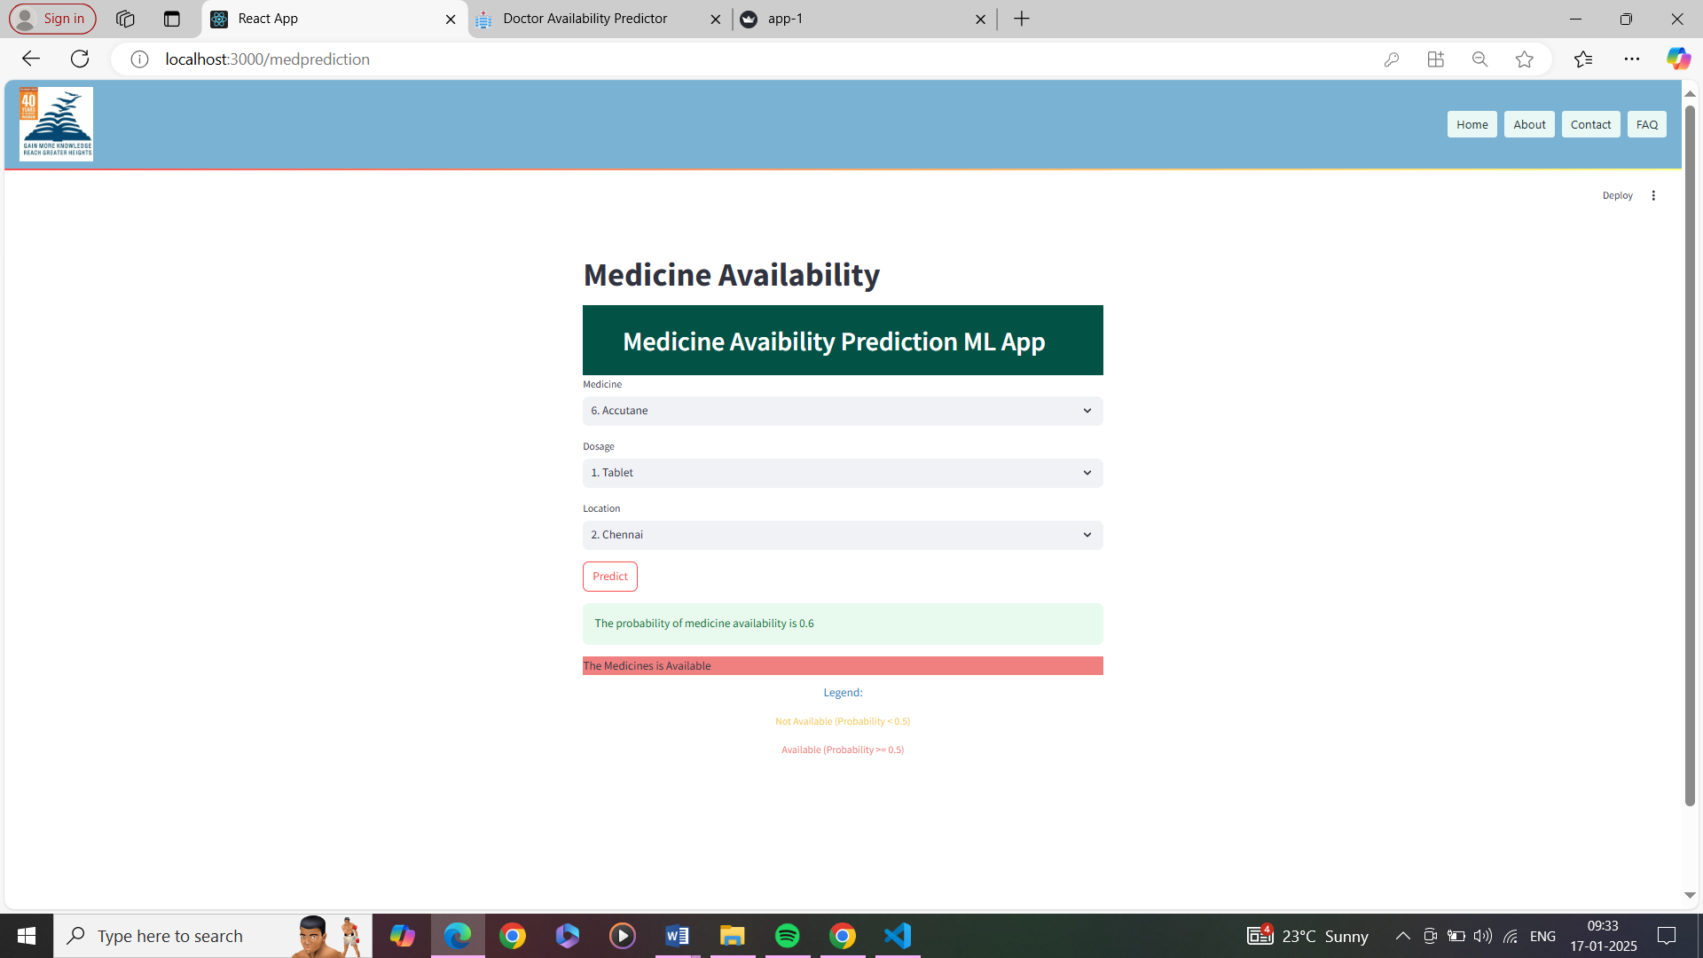
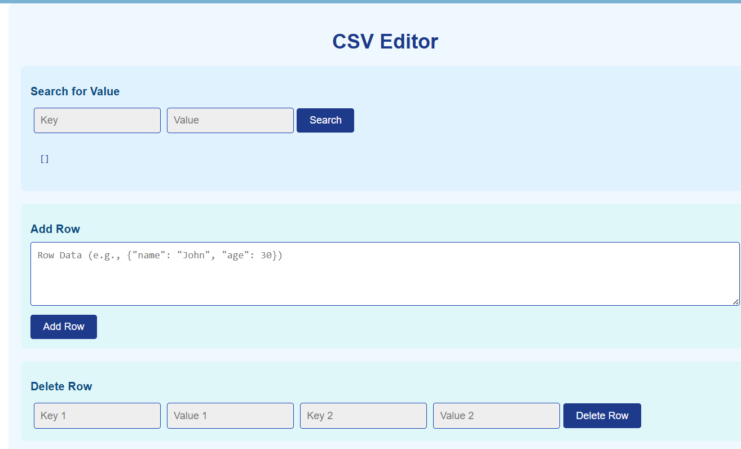
Fig 1.12 Medicine csv editor
Fig 1.10 Staff side medicine availability prediction(YES)

Slide 19

Project work mapping with SDG
aligns with SDG 3: Good Health and Well-Being.
Predictive analysis identifies gaps in medical resources, optimizes supply chains, and forecasts future needs. Data-driven insights enable efficient allocation of medicines and healthcare professionals, reducing shortages and improving outcomes.

Slide 20
Conclusion
Government hospitals face significant challenges during peak disease times due to medicine shortages and doctor unavailability. Our system offers a solution by leveraging analytics for better resource management.
By predicting medicine requirements through historical and current patient data, hospitals can maintain adequate stock. This ensures patients receive timely treatment, even during high-demand periods.
Similarly, the system optimizes doctor availability based on patient inflows, preventing shortages during critical times. This improves patient access to necessary care during weekends, holidays, and peak disease outbreaks.
Overall, this program, targeting the Indian Government healthcare sector, enhances operational efficiency. It ensures hospitals are well-prepared to handle surges in patient numbers, improving overall healthcare outcomes.

Slide 21
Github Link
Github Link
https://github.com/predictiveAnalysisonMedicinesDoctors

Slide 22
References
[1]. YiChuan Wang, LeeAnn Kung, Chaochi Ting, “Beyond a Technical Perspective: Understanding Big Data Capabilities in Health Care”, publications on. ResearchGate, 2015
[2]. Baker, R. S. J. D. “Learning, schooling, and data analytics”. Handbook on innovations in learning for states, districts, and schools, Philadelphia, PA: Center on Innovations in Learning , 2013, pp. 179–190
[3]. BasU.A, “Five pillars of prescriptive analytics success”s. Analytics-magazine.org, 2013, pp. 8–12.
[4]. Ben K. Daniel, “Big Data and analytics in higher education: Opportunities and challenges”, British journal of educational technology. September, 2015.
[5]. Raghupathi, W, “Big data analytics in healthcare: promise and potential. Health Information Science and Systems, volume2, 2014.
[6]. Bharadwaj, A, El Sawy, O.A. Palou, P.A. and Venkatraman, “Digital Business Strategy: Toward A Next Generation of Insights”, MIS Quarterly, 2013.
[7]. C. Mohanapriya, “A Trusted Data Governance Model For Big Data Analytics”, Volume 1, Issue 7, ISSN (online): 2349- 6010, Dec 2014.
[8]. Aiden, E., Michel, “The Predictive Power of Big Data. News week”. April 2014.
[9]. Sunil Erevelles, Nobuyuki Fukawa, Linda Swayne, “Big Data consumer analytics and the transformation of marketing”, Journal of Business Research, JBR- 08469, July 2015.
[10]. V. Ambrosini et al. What are dynamic capabilities and are they a useful construct in strategic management?

Slide 23
References
[11] Patel, S. (2024). Managing healthcare resources effectively during peak times. Healthcare Management Review, 35(3), 89-101. https://journals.lww.com/healthcaremanagement/Fulltext/2024/05000/Managing_Healthcare_Resources_Effectively_During.10.aspx
[12] Barlow, M. A., & Vassallo, S. R. (2023). Optimizing medicine inventory management using predictive analytics. IEEE Transactions on Biomedical Engineering, 70(1), 25-34. https://ieeexplore.ieee.org/document/9348765
[13] Smith, J. (2023). Improving hospital efficiency with predictive modelling of doctor availability. International Journal of Health Information Systems and Informatics, 19(4), 45-59. https://www.igi-global.com/article/improving-hospital-efficiency/210586
[14] Sharma, K., & Patel, R. (2022). Enhancing healthcare resource management with patient inflow prediction. Journal of Healthcare Management, 18(3), 56-68. https://www.journalofhealthcaremanagement.org/article/7568998
[15] Singh, P., & Kumar, A. (2021). Predictive analytics for doctor and specialist allocation in hospitals. International Journal of Medical Informatics, 140, 104136. https://www.sciencedirect.com/science/article/abs/pii/S1386505619310312

Slide 24
Thank You

